Slide 1
GreenSheets Recommendations
Presented on: 08-June-2016

Slide 2
Project scope
Fix recurring production issues
Greensheets Submission (Major reoccurring issue (PD Greensheet)
Greensheets Timeout (Major reoccurring issue)
Duplicate greensheets (only reoccurring occasionally)
Accommodate additional business needs:
Previously agreed upon:
Provide reporting capabilities
Ad-hoc reports on statistics related to answers to a specific question
User-friendly dashboard report to easily access the grants and the underlying greensheets and also to help visualize some of the key metrics. This is house-keeping” reports, for example ‘how many greensheets in Submitted status
Enhance search capabilities
Enhance security
UI modernization and usability
New (questions):
Using additional capabilities of Form Builder
Changes to business flow and navigation
Compliance document retention policy

Slide 3
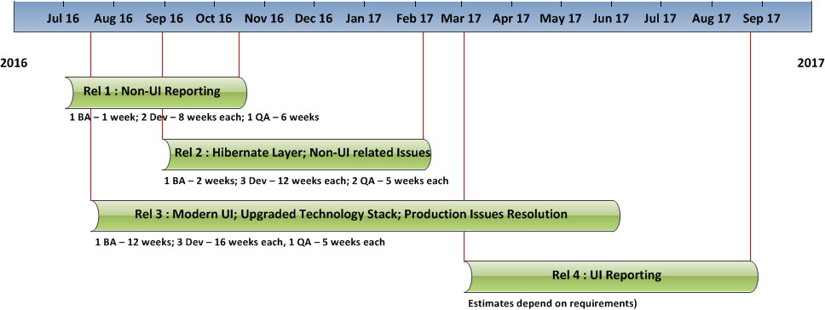
Possible project chart and resource allocation
Notes
The resource allocation indicates optimal number of developers working on a project
Project duration can be shortened by adding additional QA and Dev resource to the release 3
Release 4 is optional if OGA use other tools for reporting purposes

Slide 4
High level list of recommendations for re-design
# | Recommendations | Description
1 | Non UI reporting | Modify Greensheets database so it will allow run ad-hoc reports on statistics related to answers to a specific question on demand. Design and implement new schema to store questions and other objects needed for reporting Database migration
2 | Upgrade technology stack | Hibernate transactional framework Struts 2 MVC framework Modern front-end frameworks like Bootstrap, JQuery, CSS, etc.
3 | UI re-design | Search functionality re-design (must) Greensheets submission issue – address usability (must) Help system re-design Navigation and business flow enhancements (possible) Overall look and feel re-design to make it consistent with other NCI systems Solutions to issues related to multiple open windows 508 compliance
4 | Roles’ re-design | Diversity supplement director Guest user Super User Possible changes to roles related to promotion/rejection of draft templates
5 | UI reporting | The system will allow users to enter search parameters and run ad-hoc reports on statistics related to answers to a specific question in specified output format Dashboard report (graphic visualization): The system will provide a user-friendly dashboard report to easily access the grants and the underlying Greensheets and also to help visualize some of the key metrics. These are “house-keeping” reports, for example ‘how many greensheets in Submitted status.

